Slide 1


Muscle Fat Infiltration prediction from DEXA indicators
Priyanko Basuchaudhuri

Slide 2
Data & Task
We have patients data in broadly 3 categories – General Health Parameters (Age, Height , Weight , BMI etc.) , MRI derived parameters , DEXA derived parameters
Target Data – Muscle Fat Infiltration (Anterior thigh muscle fat infiltration, Posterior thigh muscle fat infiltration, Muscle fat infiltration )
Build model to Predict MFI from DEXA parameters

Slide 3
Data Cleanup & Preparation
Very Sparse Data – Total Records ~ 500K
Around 450K records has less than 90% data points populated – i.e. Only registration data – Age , Sex available
For Simplicity we will focus only one Target Data point – Muscle Fat Infiltration ('Muscle fat infiltration | Instance 2’)

Slide 4
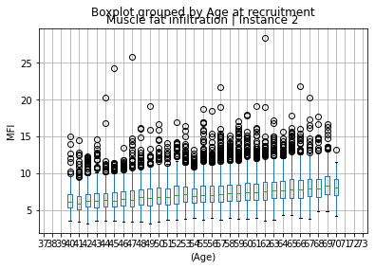
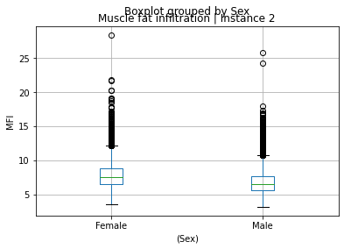
Data Cleanup & Preparation
Age and Sex has very pronounced trend with respect to MFI – With Age MFI increases , MFI higher in Female population

Slide 5
Data Cleanup & Preparation
We will exclude Age and Sex from Model building – will only consider DEXA features , otherwise feature importance of DEXA parameters will be indetermined
After first round of Data Cleanup – excluding records with less that 90% of features – found another ~ 30K records without Muscle Fat Infiltration data. These are excluded as well.
Around 130 features however lot of them are very sparse

Slide 6
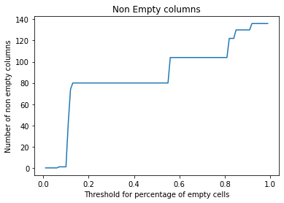
Data Cleanup & Preparation
Around only 80 columns where the empty cell is less than 40 – 20 percent , however if we move empty cell threshold around 11 percent , only 42 columns meet the criteria.
Since , we will further impute data – to minimize effect of synthetic data only consider 20 percent threshold (i.e. columns with less than 20 percent empty cells)

Slide 7
Data Cleanup & Preparation
After these cleanup steps we finally have data with – only DEXA features and MFI – around 22K records with 80 features
We use a K-Nearest Neighbor (KNN) imputer to fill up the missing data against each feature.
We assume here data is missing randomly and there is no pattern in missing data – hence data imputation based on 2 – nearest data points suitable

Slide 8
Data Cleanup & Preparation
After these cleanup steps we finally have data with – only DEXA features and MFI – around 22K records with 80 features
We use a K-Nearest Neighbor (KNN) imputer to fill up the missing data against each feature.
We assume here data is missing randomly and there is no pattern in missing data – hence data imputation based on 2 – nearest data points suitable

Slide 9
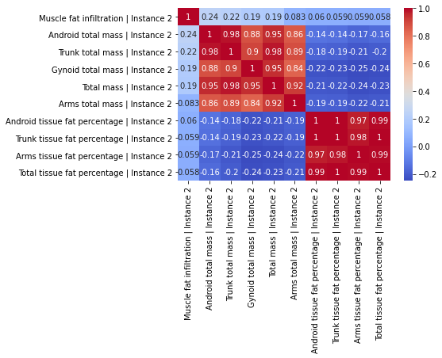
Feature Selection
First we try using a correlation matrix of the features – it reveals none of the features highly correlated to MFI – however the features have cluster among themselves i.e. features highly correlated among each other (like total mass features among themselves, fat percentage features etc.)
Need to apply further feature selection.

Slide 10
Feature Selection
2 approaches were used.
Built a baseline Random Forest Regressor model to find 20 most important features.
Built a baseline Lasso linear regression model to find top 20 features with non zero coefficients
Down the line used both these set of features to build model – however performance slightly vary.
Kept – 20 most important features from Random Forest Regressor model – as they had more features indicating percentage body fat in various sections – feature seems naturally normalized.

Slide 11
Validation Criteria
ROC – AUC for regression model
ROC-AUC is useful for classification models – where we choose the decision boundary based on AUC , to put a balance between false negative and false positive prediction.
However , for regression task for a continuous variable this usage is void
We consider , any two data points a, b , such as a > b – and count how many times pred(a) > pred(b) , finally divide the count by number of such pairs. AUC score defined as probability of given a>b , also perd(a)>pred(b) : P( pred(a) > pred(b) | a >b)

Slide 12
Validation Criteria
We use custom scorer functions in standard sci kit learn library to find best model hyperparameters that provide higher AUC score.
AUC score is not a smooth curve – we can not do derivation on this curve , hence Neural Network Loss can not be mimicked for AUC score.
We also calculated RMSE in models and tried to find in results if minimization of RMSE and Maximization of AUC are mutually separate.

